Slide 1

Software Design and Analysis Week-02 Lecture-01
Dr. Syed Muazzam Ali Shah
Assistant Professor
Department of Computer Science
National University of Computer and Emerging Sciences

Slide 2
Domain Model : Introduction
A domain model is a representation of real-world conceptual classes - not of software components.
A domain model is used as a source of inspiration for designing software objects
A domain model is the most important artifact created during object-oriented analysis.

Slide 3
Domain Model : Introduction
A domain model is a visual representation of conceptual classes or real-world objects in a domain of interest.
Domain models are also called conceptual models, domain object models, and analysis object models.
UP defines a Domain Model as one of the artifacts that may be created in the Business Modeling discipline.

Slide 4
Domain Model : UML Notation
Using UML notation, a domain model is illustrated with a set of class diagrams in which no operations are defined.
It may show:
Domain objects or conceptual classes
Associations between conceptual classes
Attributes of conceptual classes
e.g. A partial domain model
Conceptual class of Payment and Sale are significant in this domain.
Payment is related to a Sale in a way that is meaningful to note.
Sale has a date and time.

Slide 5
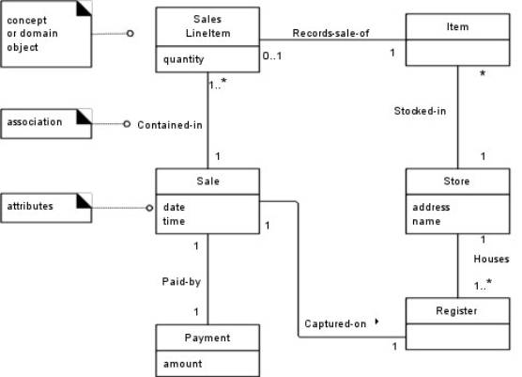

Slide 6
Key Idea: Domain Model—A Visual Dictionary of Abstractions
It visualizes and relates some words or conceptual classes in the domain.
It depicts an abstraction of the conceptual classes.
The model displays a partial view, or abstraction, and ignores uninteresting (to the modelers) details.
May be considered a visual dictionary of the noteworthy abstractions, domain vocabulary, and information content of the domain.

Slide 7
Domain Models Are not Models of Software Components
A domain model is a visualization of things in the real world domain of interest
Following elements not suitable in a domain model:
Software artifacts, such as a window or a database, unless the domain being modeled is of software concepts, such as a model of graphical user interfaces.
Responsibilities or methods.

Slide 8
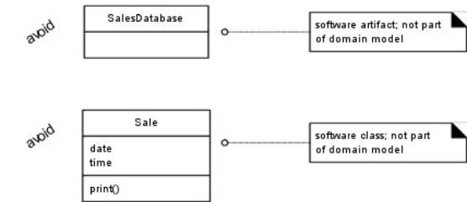
Domain Models Are not Models of Software Components

Slide 9
Conceptual Classes
The domain model illustrates conceptual classes or vocabulary in the domain.
Informally: a conceptual class is an idea, thing, or object.
Formally: a conceptual class may be considered in terms of its symbol, intension, and extension
Symbol—words or images representing a conceptual class.
Intension—the definition of a conceptual class.
Extension—the set of examples to which the conceptual class applies.

Slide 10
Conceptual Classes
e.g., conceptual class for the event of a purchase transaction
Name (Symbol) - Sale.
Intension of a Sale - “represents the event of a purchase transaction, and has a date and time.”
Extension of Sale - the set of all sales.
Usually symbol and intentional view of a conceptual class are of most practical interest.

Slide 11
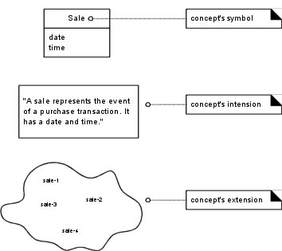
Conceptual Classes

Slide 12
Domain Models and Decomposition
Decomposition—divide-and-conquer—common strategy to deal with complexity by division of the problem space into comprehensible units.
Object-oriented analysis - the dimension of decomposition is fundamentally by things or entities in the domain (aka classes).
Primary analysis task - identify different concepts in the problem domain and document the results in a domain model.

Slide 13

Domain Models and Decomposition
Conceptual Classes in the Sale Domain:
e.g. the real-world domain of sales in a store, there are the conceptual classes of Store, Register, and Sale.
Therefore, our domain model, may include Store, Register, and Sale.

Slide 14
Conceptual Class Identification
Goal: create a domain model of interesting or meaningful conceptual classes in the domain of interest (sales) - concepts related to the use case Process Sale.
Central task: identify conceptual classes related to the scenarios under design.
Useful guideline in identifying conceptual classes:
It is better to over specify a domain model with lots of fine-grained conceptual classes than to underspecify it.
Common to miss. conceptual classes during the initial identification

Slide 15
Strategies to Identify Conceptual Classes
Two techniques:
Use a conceptual class category list.
Identify noun phrases.

Slide 16
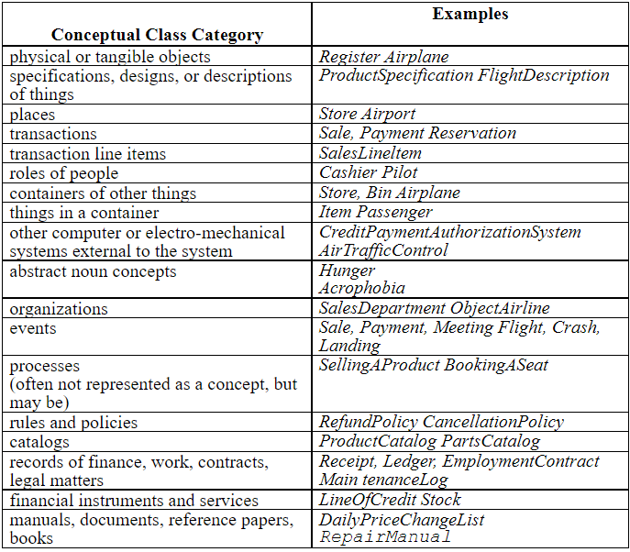
Use a Conceptual Class Category List
Start the creation of a domain model by making a list of candidate conceptual classes.
Many common categories in table.

Slide 17
Conceptual Classes: Identify Noun Phrase
Useful technique - linguistic analysis:
Identify nouns and noun phrases in textual descriptions of a domain
Consider them as candidate conceptual classes or attributes.
Note: mechanical noun-to-class mapping isn’t possible, and words in natural languages are ambiguous.
Fully dressed use cases are an excellent description for this analysis.
e.g., scenario of the Process Sale use case

Slide 18
Conceptual Classes: Identify Noun Phrase
Main Success Scenario (or Basic Flow):
Customer arrives at a POS checkout with goods and/or services to purchase.
Cashier starts a new sale.
Cashier enters item identifier.
System records sale line item and presents item description, price, and running total. Price calculated from a set of price rules.
Cashier repeats steps 2-3 until indicates done.
System presents total with taxes calculated.
Cashier tells Customer the total, and asks for payment.
Customer pays and System handles payment.
System logs the completed sale and sends sale and payment information to the external Accounting (for accounting and commissions) and Inventory systems (to update inventory).
System presents receipt.
Customer leaves with receipt and goods (if any).

Slide 19
Conceptual Classes: Identify Noun Phrase
Extensions (or Alternative Flows):
7a. Paying by cash:
Cashier enters the cash amount tendered.
System presents the balance due, and releases the cash drawer.
Cashier deposits cash tendered and returns balance in cash to Customer.
System records the cash payment.

Slide 20

Conceptual Classes: Identify Noun Phrase
Some noun phrases are candidate conceptual classes,
Some refer to conceptual classes that are ignored in this iteration
e.g., “Accounting” and “commissions”
Some are attributes of conceptual classes.

Slide 21
Candidate Conceptual Classes for the Sales Domain
List is generated of candidate conceptual classes for the domain from the Conceptual Class Category List and noun phrase analysis,
Sample list —the simplified scenario of Process Sale.
Register
ProductSpecification
Item
SalesLineltem
Store
Cashier
Sale
Customer
Payment
Manager
ProductCatalog

Slide 22
Domain Modeling Guidelines
How to Make a Domain Model
Apply the following steps to create a domain model:
List the candidate conceptual classes using the Conceptual Class Category List and noun phrase identification techniques
Draw them in a domain model.
Add associations necessary to record relationships for which there is a need to preserve some memory
Add the attributes necessary to fulfill the information requirements

Slide 23
On Naming and Modeling Things - The Mapmaker
The mapmaker strategy applies to both maps and domain models.
Make a domain model in the spirit of how a cartographer or mapmaker works:
Use the existing names in the territory.
Exclude irrelevant features.
Do not add things that are not there.

Slide 24
On Naming and Modeling Things - The Mapmaker
A domain model is a kind of map of concepts or things in a domain.
A mapmaker uses the names of the territory—they do not change the names of cities on a map.
Domain model - use the vocabulary of the domain when naming conceptual classes and attributes.
A mapmaker deletes things from a map if they are not considered relevant to the purpose of the map
Domain model - exclude conceptual classes in the problem domain not pertinent to the requirements.
A mapmaker does not show things that are not there
Domain model - exclude things not in the problem domain under consideration.

Slide 25
Common Mistake in Identifying Conceptual Classes
Most common mistake - to represent something as an attribute when it should have been a concept.
Rule of thumb:
If we do not think of some conceptual class X as a number or text in the real world, X is probably a conceptual class, not an attribute.
e.g., should store be an attribute of Sale, or a separate conceptual class Store?
Real world - a store is not considered a number or text—the term suggests a legal entity, an organization, and something occupies space.
Therefore, Store should be a concept

Slide 26
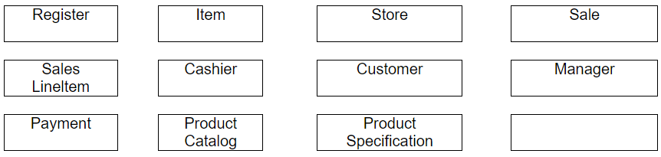
The NextGen POS Domain Model
List of conceptual classes for the NextGen POS domain may be represented graphically to show the start of the Domain Model.

Slide 27
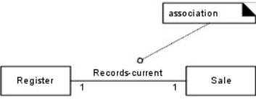
Domain Model: Adding Associations
Identify associations of conceptual classes needed to satisfy the information requirements of the current scenarios, and aid in comprehending the domain model.
An association is a relationship between instances of those types that indicate some meaningful and interesting connection.

Slide 28
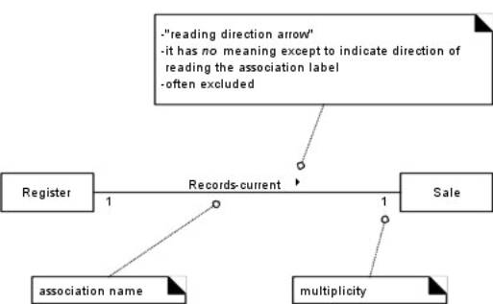
The UML Association Notation
An association is represented as a line between classes with an association name.
The association is inherently bi-directional.

Slide 29
The UML Association Notation
Ends of an association may contain a multiplicity expression
Indicating the numerical relationship between instances of the classes.
Optional “reading direction arrow” indicates the direction to read the association name.
Conventional to read the association from left to right or top to bottom,
Although the UML does not make this a rule.
Reading direction arrow has no meaning in terms of the model;
It is only an aid to the reader of the diagram.

Slide 30
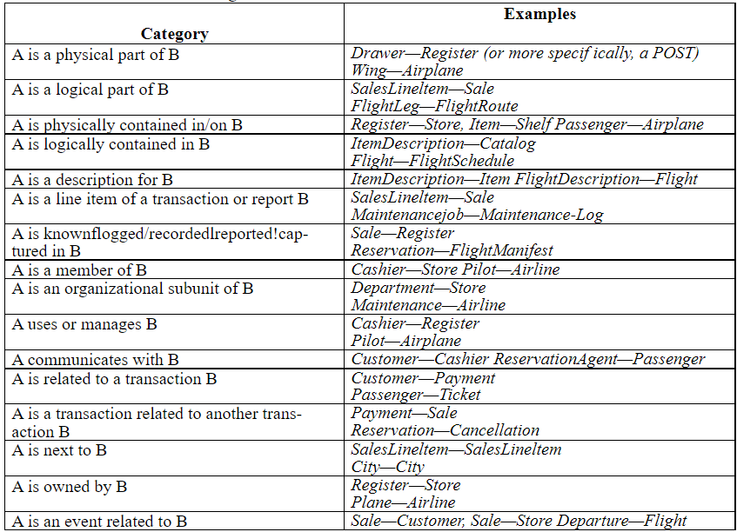
Finding Associations—Common Associations List
Start the addition of associations by using the list in Table below.
Table contains common categories

Slide 31
High-Priority Associations
High-priority association categories useful to include in a domain model:
A is a physical or logical part of B.
A is physically or logically contained in/on B.
A is recorded in B.

Slide 32
Association Guidelines
Focus on those associations for which knowledge of the relationship needs to be preserved for some duration (“need-to-know” associations).
It is more important to identify conceptual classes than to identify associations.
Too many associations tend to confuse a domain model rather than illu­minate it.
Their discovery can be time-consuming, with marginal benefit.
Avoid showing redundant or derivable associations.

Slide 33
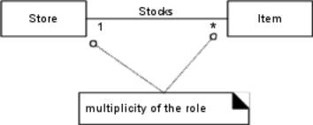
Multiplicity
Multiplicity defines how many instances of a class A can be associated with one instance of a class B.
e.g., single instance of a Store can be associated with “many” (zero or more,indicated by the * ) Item instances.

Slide 34
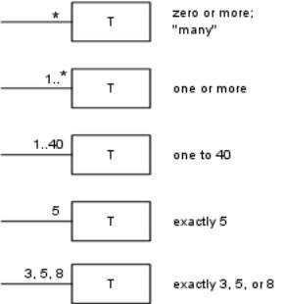
Multiplicity

Slide 35
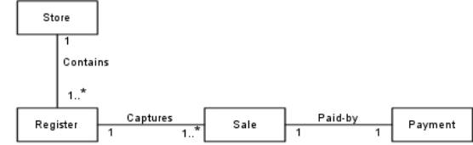
Naming Associations
Name an association based on a TypeName-VerbPhrase-TypeName format.
Association names should start with a capital letter.
UML - classifiers should start with a capital letter.
Two common formats for a compound association name are:
Paid-by
PaidBy

Slide 36
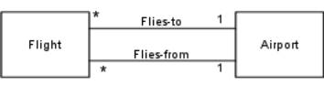
Multiple Associations Between Two Types
Two types may have multiple associations between them
e.g. - Domain of the airline:
Relationships between a Flight and an Airport
Flying-to and flying-from associations are distinctly different relationships

Slide 37

Domain Model: Adding Attributes
Identify attributes of conceptual classes that are needed to satisfy the information requirements of the current scenarios under development.
Attributes
An attribute is a logical data value of an object.
Include attributes for which the requirements suggest a need to remember information.
Attributes are shown in the second compartment of the class box
Their type may optionally be shown.

Slide 38
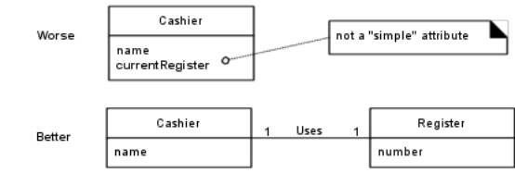
Keep Attributes Simple
Most simple attribute types are often thought of as primitive data types, such as numbers.
Type of an attribute should not be a complex domain concept

Slide 39
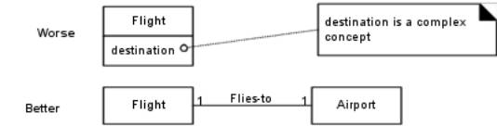
Keep Attributes Simple
Attributes in a domain model should be simple attributes or data types.
Common attribute data types include: Boolean, Date, Number, String (Text), Time

Slide 40
Attributes in the NextGen Domain Model
Payment | amount—To determine if sufficient payment was provided, and to calculate change, an amount (also known as “amount tendered”) must be captured.
Product-Specification | description—To show the description on a display or receipt.
 | id—To look up a ProductSpecification, given an entered itemID, it is necessary to relate them to a id.
 | price—To calculate the sales total, and show the line item price.
Sale | date, time—A receipt is a paper report of a sale. It normally shows date and time of sale.
SalesLineltem | quantity—To record the quantity entered, when there is more than one item in a line item sale (for example, five packages of tofu).
Store | address, name—The receipt requires the name and address of the store.

Slide 41
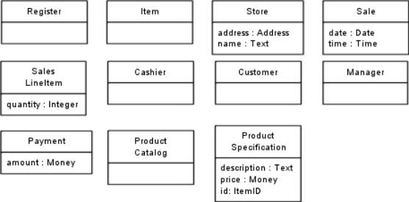
Attributes in the NextGen Domain Model

Slide 42
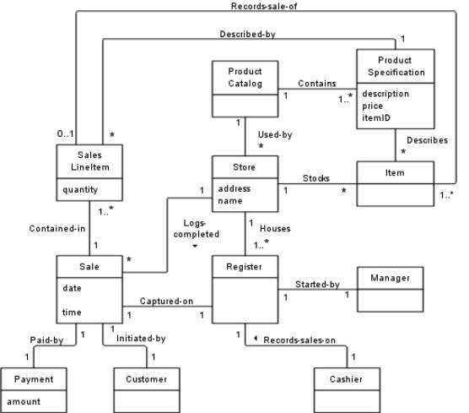
Domain Model Conclusion
Combining the conceptual classes, associations, and attributes yields the model illustrated.
Relatively useful domain model for the domain of the POS application has been created.
No a single correct model.

Slide 43
End of Lecture Any Question ?

